Slide 1
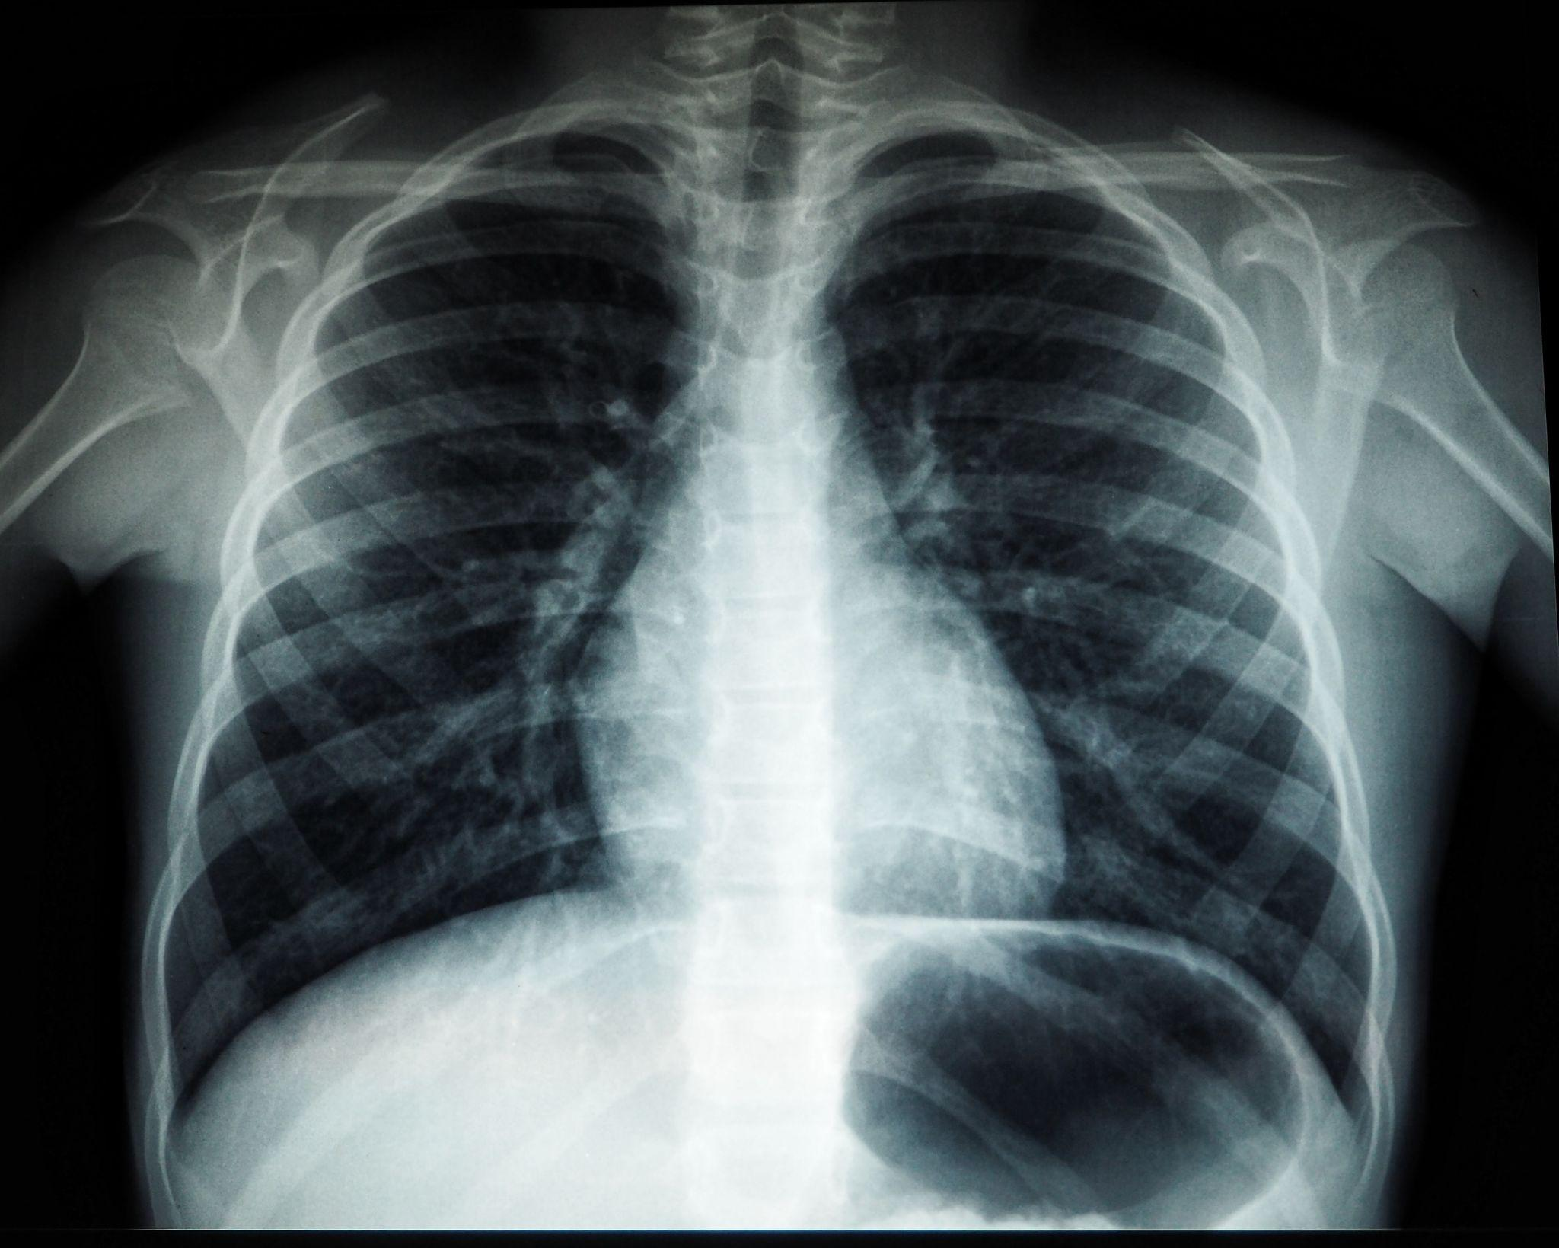

Multitask learning for Pneumonia Detection on Chest X-Ray Images
Guided By:
Prof. Dr. Di Wu
Presented By:
Sushil R Deore
Charan Singh
Vishadh Sawant
University of Colorado Boulder
Master of Science in Data Science
CSCI 5502-072

Slide 2
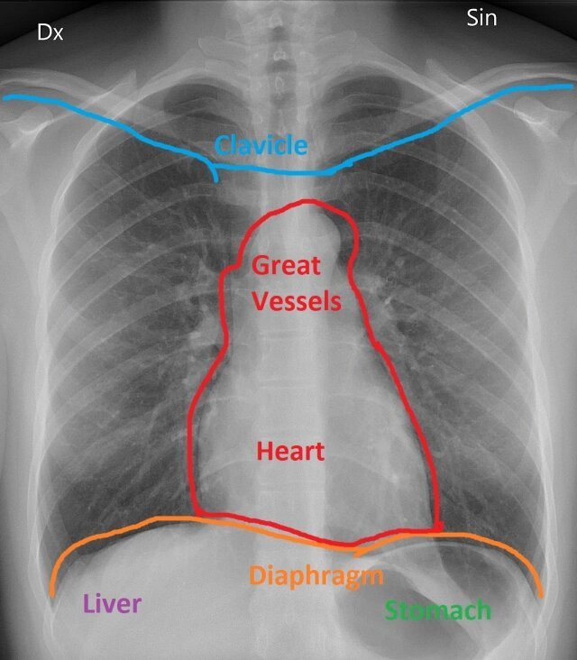
Contents:
Introduction on Pneumonia Detection Problem
What is Multitask learning?
Related Work
Proposed Setup
Evaluation
Milestones/Project Plan
References
Figure: Labeled Chest X-Ray[2]

Slide 3
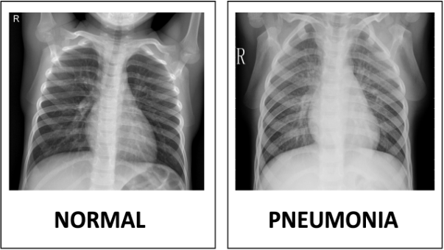
Introduction on Pneumonia Detection Problem
Pneumonia is a life-threatening lung infection, resulting from several different viral infections
Problem in detection due to similarity to other pulmonary (relating to the lungs) diseases
Existing methods for predicting pneumonia cannot attain substantial levels of accuracy
Figure: Normal Vs. Pneumonia Chest X-Ray[2]

Slide 4
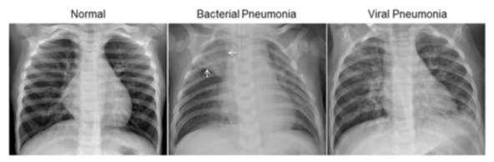
Dataset Description
The dataset is organized into 3 folders (train, test, val) and contains subfolders for each image category (Pneumonia/Normal).
There are 5,863 X-Ray images (JPEG) and 2 categories (Pneumonia/Normal).
Chest X-ray images (anterior-posterior) were selected from retrospective cohorts of pediatric patients of one to five years old from Guangzhou Women and Children’s Medical Center, Guangzhou. All chest X-ray imaging was performed as part of patients’ routine clinical care.
For the analysis of chest x-ray images, all chest radiographs were initially screened for quality control by removing all low quality or unreadable scans.
The diagnoses for the images were then graded by two expert physicians before being cleared for training the AI system.
Figure: Examples of Chest X-Rays in Patients with Pneumonia[1]

Slide 5
What is Multitask learning?
Task-Specific Layers
Shared Layers
Task 1
X- Input
Task 2
Task 3
Figure: Multitask Learning Setup[5]

Slide 6
Related Works
CheXNet is a 121-layer CNN-based approach developed by Rajpurkar et al. [4] The approach was also applied using 420 chest X-rays, and the results were compared with those of radiologists. Therefore, it was found that the DL-based CNN method outperformed the average performance of radiological pneumonia detection.
In [5], they trained a CNN method from scratch to retrieve features from chest X-ray images to achieve excellent classifier performance and used it to detect whether or not a patient had pneumonia, in contrast with previous studies based on traditional manual features.
Wu et al., in [5], suggested a method based on adaptive average filtration CNN and random forest to predict pneumonia using chest X-ray images.

Slide 7
Proposed Setup
Classification loss
Classification Task
Pneumonia Classification
X-Ray
Images
Parameter Sharing
Backpropagation
Combined Loss
Lesion
Segmentation
Segmentation
loss
Segmentation Task
Figure: Multitask Learning Setup

Slide 8
Evaluation
Accuracy: This is the number of correct predictions made by the model divided by the total number of predictions. It is a common metric used to evaluate the performance of classification models.
Accuracy = (True Positives + True Negatives) / Total Predictions
Precision: This is the number of true positive predictions made by the model divided by the total number of positive predictions. Precision measures how well the model is able to avoid false positive predictions.
Precision = True Positives / (True Positives + False Positives)
Recall (or Sensitivity): This is the number of true positive predictions made by the model divided by the total number of actual positive cases. Recall measures how well the model is able to identify all positive cases.
Recall = True Positives / (True Positives + False Negatives)

Slide 9
Evaluation
F1 Score: This is the harmonic mean of precision and recall. The F1 Score is a commonly used metric that provides a balance between precision and recall and is particularly useful when the distribution of positive and negative cases is imbalanced.
F1 Score = 2 * Precision * Recall / (Precision + Recall)
Receiver Operating Characteristic (ROC) Curve: This is a graphical representation of the relationship between the true positive rate and the false positive rate for a classification model as the threshold for making predictions is varied. The area under the ROC curve (AUC) is often used as a summary metric to evaluate the performance of a classification model.
Note: In these formulas,
True Positives (TP) are the number of positive cases that were correctly identified by the model,
False Positives (FP) are the number of negative cases that were incorrectly identified as positive,
True Negatives (TN) are the number of negative cases that were correctly identified,
False Negatives (FN) are the number of positive cases that were incorrectly identified as negative.

Slide 10
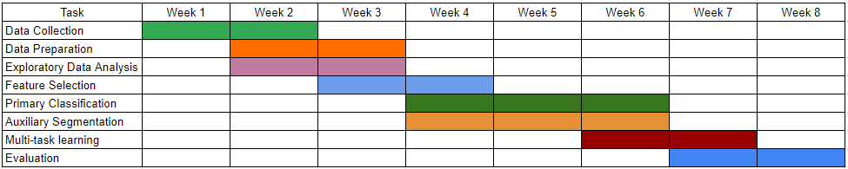
Project Plan
Figure: Project Plan

Slide 11
References
Dataset link :https://data.mendeley.com/datasets/rscbjbr9sj/2 https://www.kaggle.com/datasets/paultimothymooney/chest-xray-pneumonia
https://blogs.sap.com/2020/06/28/digital-covid-19-detection-kit-based-on-chest-x-ray-using-machine-learning-and-sap-conversational-ai/
https://glassboxmedicine.com/2019/02/10/radiology-normal-chest-x-rays/
https://dl.acm.org/doi/fullHtml/10.1145/3431804
https://link.springer.com/article/10.1007/s11042-018-6463-x
CheXNet: Radiologist-Level Pneumonia Detection on Chest X-Rays with Deep Learning
Pneumonia Detection on Chest X-ray Images Using Ensemble of Deep Convolutional Neural Networks
Application of the AI System for Pneumonia Detection Using Chest X-Ray Images
Auxiliary Tasks in Multitask learning
Accurate tumor segmentation via octave convolution neural
A deep feature learning model for Pneumonia detection applying a combination of mRMR feature selection and ml

